Slide 1
D209 Data Mining I Performance Assessment Task 1: Classification Analysis
Jill Rivera, Student
Masters of Science: Data Analytics
Western Governors University
Notes:
Hello and welcome. My name is Jill Rivera. I am a student in the Master of Science program for Data Analytics. Today, I will be going over the first performance assessment for class D209 Data Mining I. This task will focus on Classification Analysis.

Slide 2

Performance Task 1
Given: Data Dictionary and Associated Data Set
Objective: Using Classification Analysis, analyze the data set to answer a beneficial question for the business.
Notes:
This first performance task in Data Mining I will focus on analyzing a data set using classification analysis. The analysis will attempt to answer a question that is beneficial to the company’s data set.

Slide 3
Business Question
Can a new customer can be classified as high or low risk of churn using certain data points in the data set?
Notes:
Customer churn, or when a customer discontinues services with a company, is a problem that every business in the service industry deals with. This analysis will dive deeper into a data set for a telecommunications company, with the objective of understanding which customers are at a higher risk of churning from their company. This analysis will classify a new control customer as either at risk or not of churning based on given metrics. For this, the features of Monthly Charge and Tenure will be used to build a model to classify our new customer and test the model’s accuracy. The method of analysis chosen is the K-Nearest Neighbors (KNN) machine learning algorithm.

Slide 4

Agenda
Data Acquisition
Data Cleaning
Data Exploration
Data Wrangling
Classification Model
Analysis
Results
Recommendations
Questions
Notes:
The process for completing the classification analysis will be as follows: First, I will clean the data to provide a complete data set with no missing values and treating outlying data points which may skew the model. Next, I will explore the data set’s primary and target values. Next, I will wrangle the data by re-expressing the categorical feature as Boolean to be treated as a numerical data feature. I will create the model by first splitting the data into training and testing sets and run the initial model using just the training data. The model’s accuracy will be assessed and the final model will be created using all the data. Results and recommendations for the business will be presented for consideration.

Slide 5

K-Nearest Neighbors Classification Analysis
Supervised machine learning algorithm.
Calculate the distance between your target point and similar data points in the model.
Assumes: If data points are close together, then they are highly similar.
Notes:
K-Nearest Neighbors (KNN) is a supervised machine learning algorithm that is perfect for this analysis. KNN is a widely used classification method used to calculate the distance between your target point and similar data points in the model. This method uses a straight-line or Euclidean distance to solve the problem. One assumption of the KNN model is that if data points are close together, then they are highly similar. This method uses the distance between data points to determine this. Conversely, if the data points are far from each other, then they are not similar.

Slide 6


Tools
Package/ Library | Usage
Pandas | Data frame reading/writing
Numpy | Data frame manipulation
Matplotlib | Graphing variable independence
Sklearn.feature_selection: SelectKBest.f_classif | Predictive modeling package
Sklearn.preprocessing: Scale | Confusion matrix creation
Sklearn.model_selection: Train_test_split | Performance curve creation
Sklearn.pipeline: Pipeline | Building classification trees
Notes:
This analysis will be conducted using the Python programming language in a Jupyter Notebook. Both are open-source platforms that are easy to use and powerful in solving these simple machine learning algorithms. The following table displays the Python libraries that will be used in this analysis and their purpose.

Slide 7
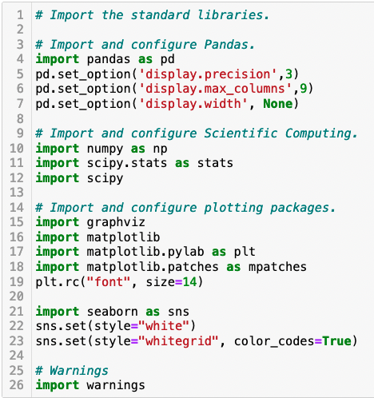
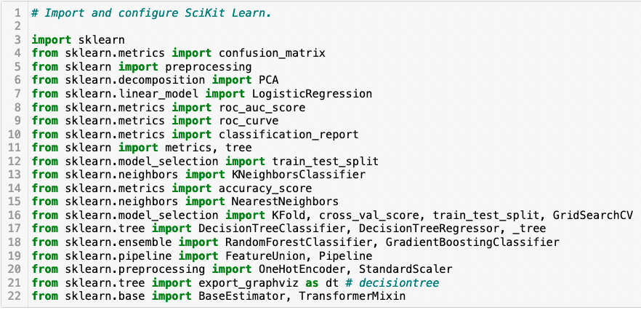
Data Acquisition: Libraries
Notes:
We begin the classification analysis by first importing the Python packages and libraries that will be needed.

Slide 8
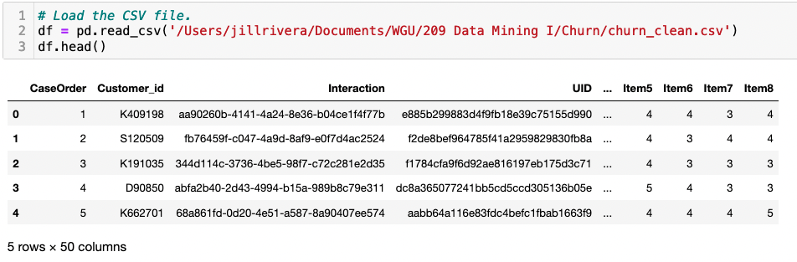
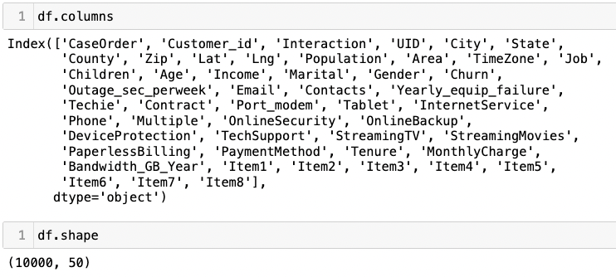
Data Acquisition: Read Data
Notes:
The CSV file is read using the Pandas read_csv method. The features of the data set are listed, and the shape of the data frame is displayed. There are a total of 50 features and 10,000 customer records in the data set.

Slide 9
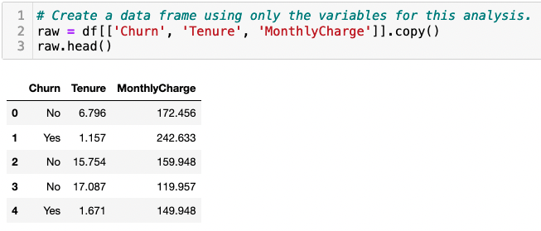
Data Cleaning: Separate Data
Notes:
A new data frame using only the variables that are used in the analysis is created, and the first five rows are displayed.

Slide 10
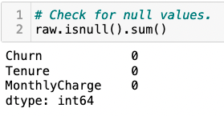
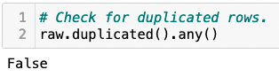
Data Cleaning: Null and Duplicate Values
Notes:
The data frame is checked for null values using the isnull and sum methods. We find no missing values in the data. The rows are checked to make sure that there are no duplicated rows of data. Using the duplicated and any methods, we find no rows are copies of each other.

Slide 11
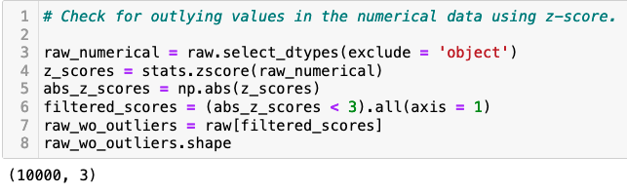
Data Cleaning: Outlying Values
Notes:
Outlying values are checked using the z-score of each variable. This proved to find no outlying values in the data.

Slide 12
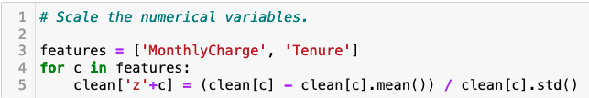
Data Cleaning: Scale Numerical Features
Notes:
The data is scaled to ensure there is an even number of true and false values.

Slide 13
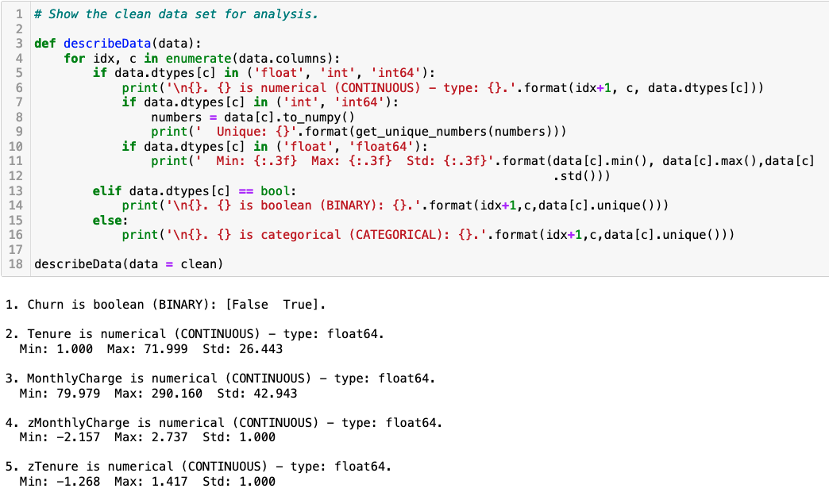
Cleaned Data
Notes:
The clean data set consists of 10,000 customer records and the churn, tenure, monthly charge, z monthly charge, and z tenure variables for classification analysis. A visualization of the features, their data type and metrics is shown. A copy of the clean data set is exported to a CSV file labeled 209clean_task1.csv. This file is attached as a submission for this assessment.

Slide 14
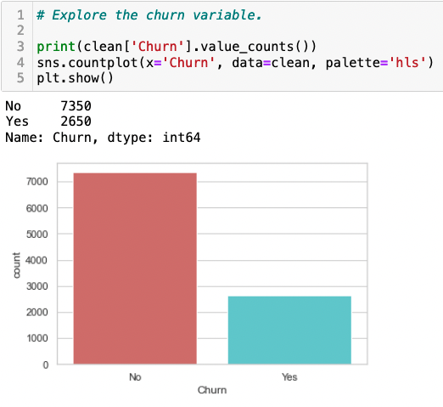
Data Exploration: Target Variable
Notes:
The target variable for this analysis is the churn feature. This variable is categorical and has yes/no values. Of the 10,000 customer records, 7,350 have not churned and 2,650 have left the company. This is visualized in a bar graph.

Slide 15
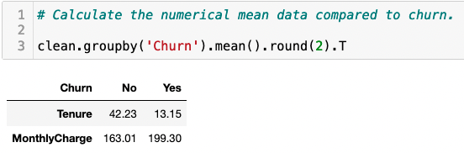
Data Exploration: Primary Features
Variable | Range | Mean
Tenure | 1.0025934 – 71.99928 | 34.53 +/- 26.44
Monthly Charge | 79.97886 – 290.160419 | 172.62 +/- 42.94
Notes:
The explanatory features that will be used are tenure and monthly charge. Both explanatory variables are continuous numerical data types. The range and mean of each are shown in the table. When comparing the target variable to the explanatory variables, the statistics can be seen. The average customer who left the company was paying $199.30 monthly and had only 13 months of service. While those who have stayed only pay $163.01 on average and have been with the company for 42 months. This shows that the customers who are paying more are leaving early on into their service.

Slide 16
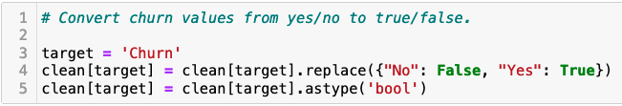
Data Wrangling
Notes:
The categorical feature of churn has yes/no values initially. These values will be changed to Boolean values of true and false. Boolean values are considered numerical or binary for such calculations. Using the replace and astype methods, the values are changed as shown.

Slide 17
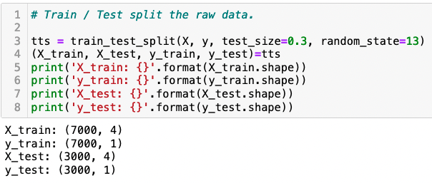
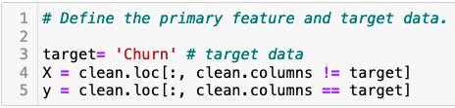
Classification Model: Train/Test Split
Notes:
The data frame will be split into training and testing data groups. This will allow the model to be built on the training data and the accuracy can be tested on the testing data. First, the primary features and target data are defined in variables X and y. The data is split into these groups using Scikit-learn’s train_test_split function, where 70% of the data is for training and the other 30% is reserved for testing. A copy of each data set is exported to a CSV file for submission. The labels of these files include 209trainData_task1.csv and 209testData_task1.csv.

Slide 18
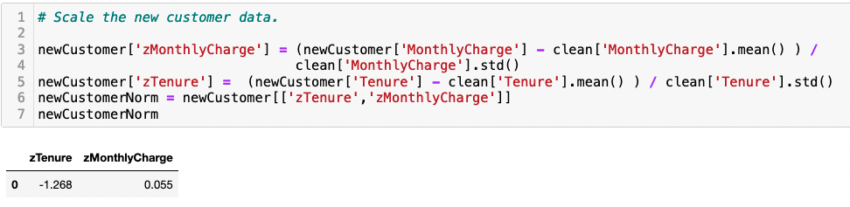
Classification Model: Define the Control
Notes:
The KNN analysis will determine if a new customer we create as a control will classify them as churn true or false, meaning more or less likely to leave the provider. First, the new customer is defined. The new customer will have a tenure value of 1.0 and a monthly charge value of 175.00. The new customer data is scaled between the primary features to distribute the values equally.

Slide 19
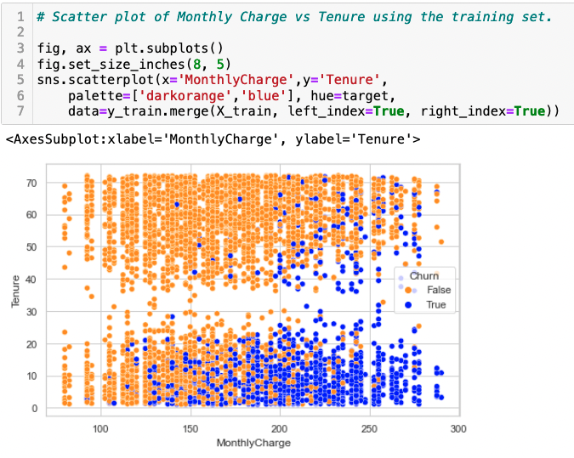
Classification Model: Training Data Plot
Notes:
A scatter plot of monthly charge compared to tenure is displayed using the training data and Seaborn.

Slide 20
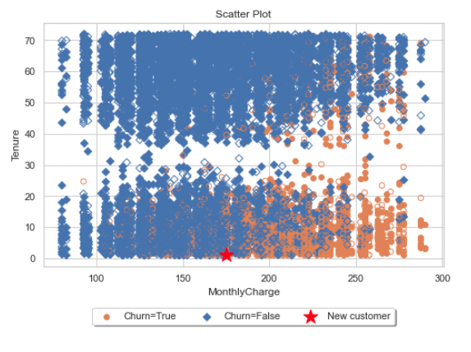
Classification Model: Testing Data Plot
Notes:
A scatter plot of the primary features is created using the testing data set.

Slide 21
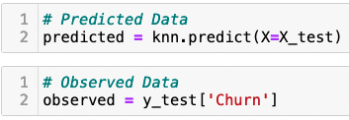
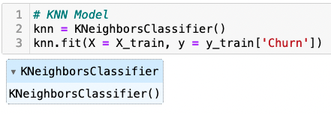
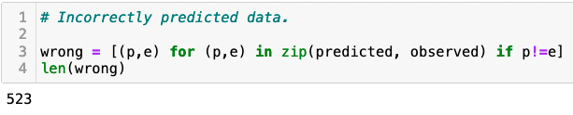
Classification Model: Model Creation
Notes:
The KNN model is created using the KNeighborsClassifier function from Scikit-learn. Predicted and observed data is defined. Incorrectly predicted data is defined and counted. There are 523 incorrectly predicted data points in the model.

Slide 22
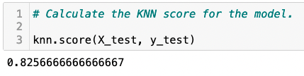
Classification Model: Accuracy Score
Notes:
The KNN score is calculated for the model using the score method. This is the accuracy score for the model created.

Slide 23
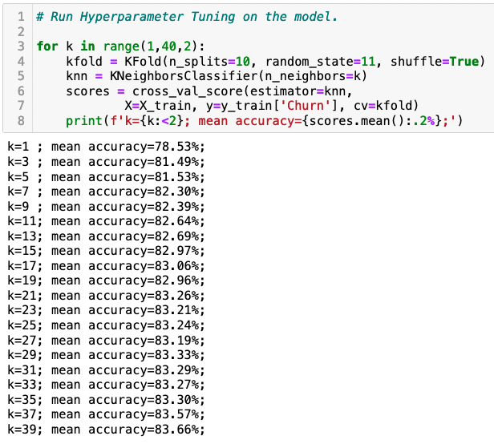
Classification Model: Hyperparameter Tuning
Notes:
Hyperparameter tuning is performed on the model to find the number of nearest neighbors that should be used in the model. Running this shows that when k is equal to seven, the accuracy of 82% is achieved.

Slide 24
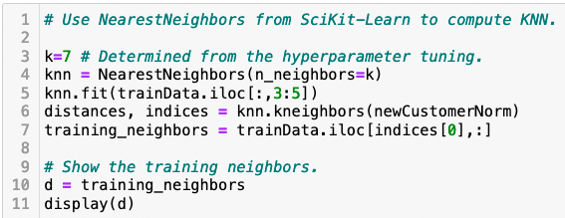
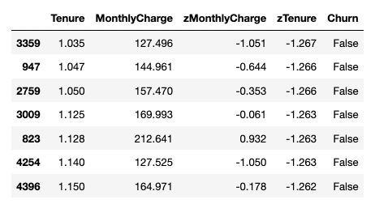
Classification Model: Training Data Run
Notes:
The Scikit-learn NearestNeighbors function is used to compute the KNN analysis on the training data. Setting the k to seven as determined in the hyperparameter tuning, yields the seven customer records that are closest to the new customer. These all indicate that the new customer should be classified as churn false.

Slide 25
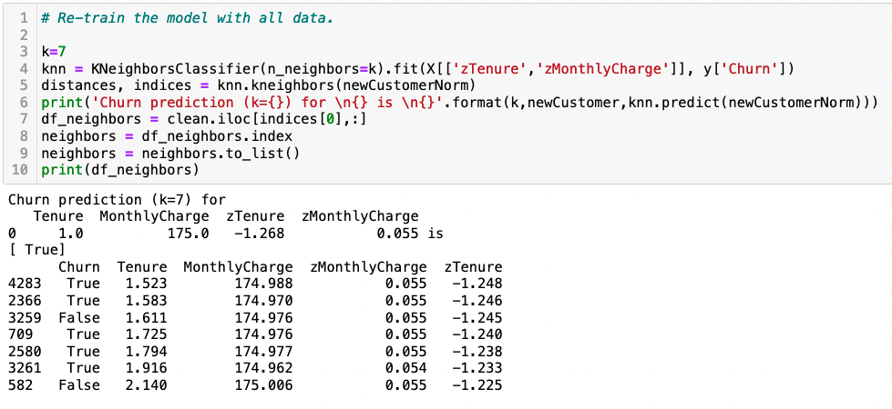
Classification Model: All Data Run
Notes:
The model is re-trained using all the data and k as seven again. This displays the seven customer records which are closest to the new customer’s metrics.

Slide 26
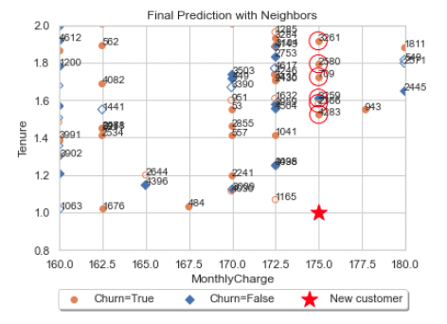
Classification Model: Final Plot
Notes:
This data is plotted in a scatter plot, with the new customer indicated as a star.

Slide 27
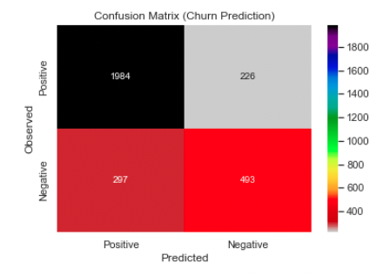
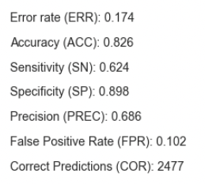
Analysis: Confusion Matrix
Notes:
A confusion matrix is created to assess the sensitivity (portion of the positive class that was correctly classified) and specificity (portion of the negative class that was correctly classified) of the model. This matrix shows that of 3000 predictions, 2477 were correct making the accuracy of the model 82.6%. Metrics for the confusion matrix verify this accuracy rate. This also verifies that there is a 17% chance of error. When put in terms of the new customer created to test the model, there is an 83% chance of them having the value of churn = True and a 17% chance of them having the value of churn = False.

Slide 28
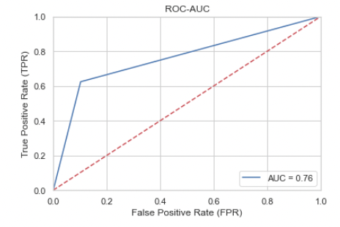
Analysis: Receiver Operating Curve
Notes:
A Receiver Operating Curve (ROC) was used to evaluate the model’s accuracy in predicting outcomes. This technique plots the true positive rate (TPR) against the false positive rate (FPR) to separate the ‘signal’ from the ‘noise’. (Bhandari, 2020) The Area Under the Curve (AUC) is a calculation used to measure the ability of the model to distinguish between the positive and negative classes. The AUC value ranges between 0 to 1, with the value of 1 meaning that there is a high chance of positive values being distinguished from negative values. When analyzing the graph of the ROC, the higher X-axis value present shows a higher number of false positives than true negatives in the model. On the other hand, a higher Y-axis value shows a larger number of true positives than false negatives in the model.

Slide 29
Results
Model Accuracy: 82%
Control Customer: 71% chance of Churn = True
Limitation: Variable Selection
7 Nearest Neighbors:
Customer Record | Churn | Tenure | Monthly Charge
4283 | True | 1.523 | 174.988
2366 | True | 1.583 | 174.970
3259 | False | 1.611 | 174.976
709 | True | 1.725 | 174.976
2580 | True | 1.794 | 174.977
3261 | True | 1.916 | 174.962
582 | False | 2.140 | 175.006
Notes:
The final model proved to maintain an accuracy of 82% using k as seven to determine the seven closest customers with similar data points to the control customer. This was verified using the AUC in the ROC graph and by calculating the KNN score.
A limitation to this analysis is the variable selection. In choosing tenure, a new customer will always have a low value for this attribute. For the KNN computation however, it is not advisable to test a parameter with such a low value. A better variable selection could be made to compare the customer’s bandwidth usage or amount of outage time they experience instead to produce a better model for new customers. This model, however, will prove useful in classifying existing customers as likely or unlikely to churn.
The final seven similar customer records to the control customer are displayed. Five out of seven of the records indicate a true churn value. This means that the control customer is at a high risk (71% chance) of leaving the provider. This could be due to the monthly payment being higher than the average calculated for the whole data set. The control data can be manipulated, and the analysis run another time using lower parameters to confirm this theory.

Slide 30
Recommendations
Additional analysis with other variables
Use model to evaluate existing customers
Flag customers at high risk and offer a discount
Notes:
Additional analysis is recommended using this model with other variables such as bandwidth or outage time experienced to see if new customers can be evaluated more accurately. Using this model to evaluate existing customers is advised to determine if their monthly charge is too high based on their tenure and propensity to churn. An existing customer flagged by the model could be offered a discount on their monthly service to decrease their risk of churning and increase their tenure.

Slide 31

Questions
Notes:
Any questions?

